Slide 1
The Current Global Macro-economy, and Risks to Global Growth December 2022 Peter K. Schott Yale School of Management & NBER

Slide 2
Agenda
What’s the current state of the global macroeconomy?
What are the major risks to growth?
Long-run prospects?

Slide 3
How would you characterize the current state of the world economy? What are the greatest risks to growth around the world?

Slide 4




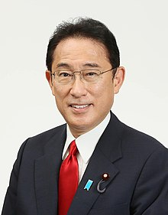
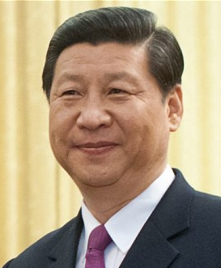
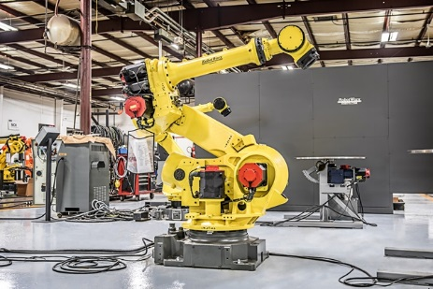


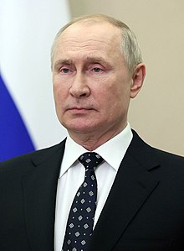
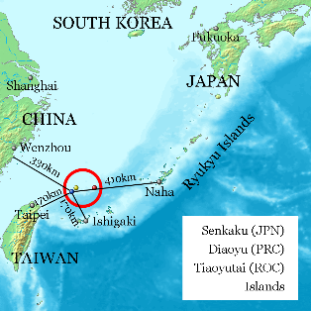




Slide 5
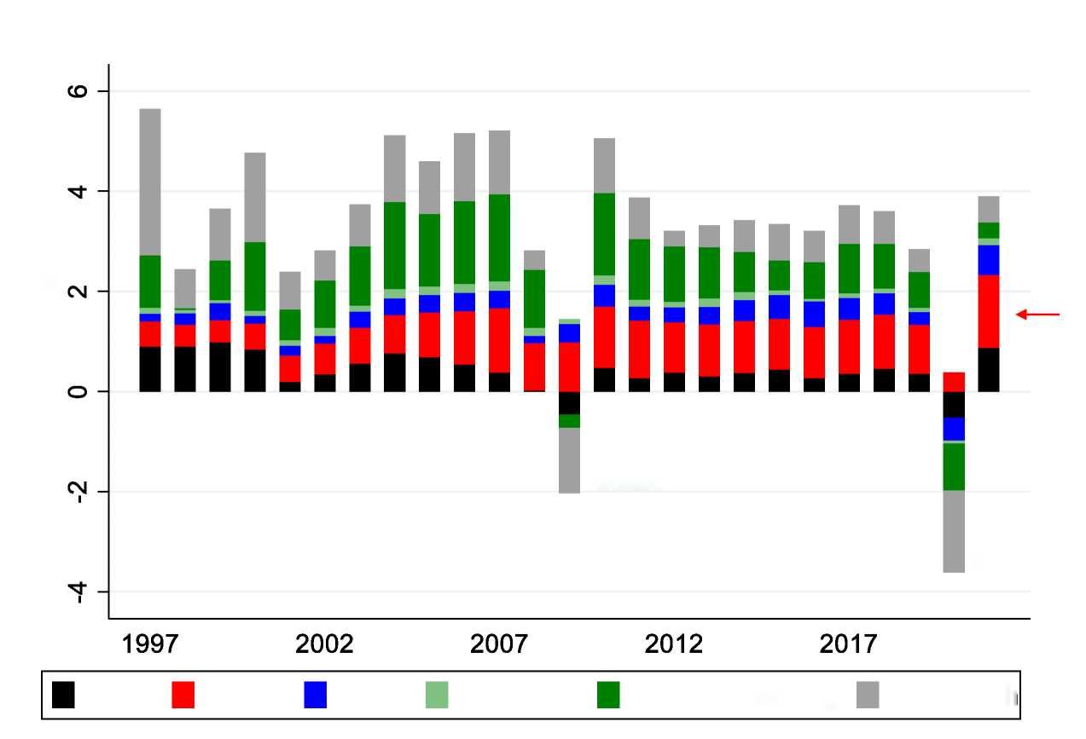
World GDP Growth 1997-2021
Contribution to World GDP Growth
Percent Growth
Great Recession
COVID
USA
China
India
SS Africa
Other Developing
Other Rich
Notes:
.do file in /executive/global_growth

Slide 6
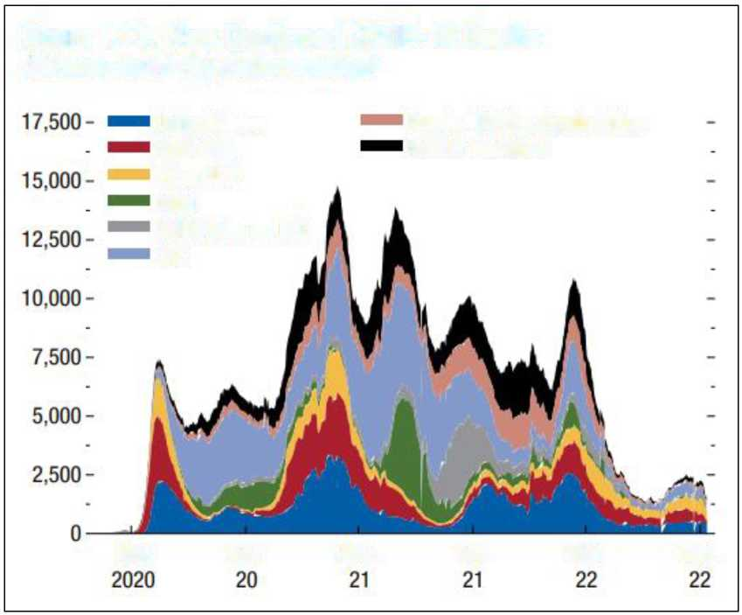
Lingering Impact of COVID
Figure 1.13. New Confirmed COVID-19 Deaths
(Persons; seven-day moving average)
United States
Russia, Türkiye, South Africa
Euro area
Rest of the world
Other AEs
India
EMDE Asia ex. IND
LAC
Mar.
Sep.
Mar.
Sep.
Mar.
Sep.
Source: IMF.

Slide 7
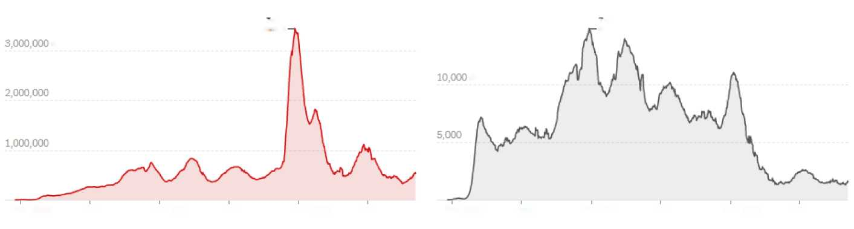
Lingering Impact of COVID
Cases
Deaths
7-day average
7-day average
cases
deaths
Feb. 2020
Aug.
Feb. 2021
Aug.
Feb. 2022
Aug.
Feb. 2020
Aug.
Feb. 2021
Aug.
Feb. 2022
Aug.

Slide 8
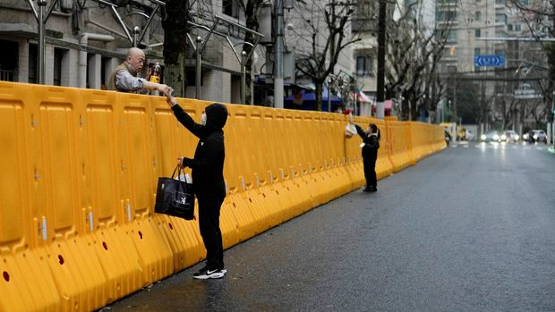
China Lockdowns Easing?

Slide 9
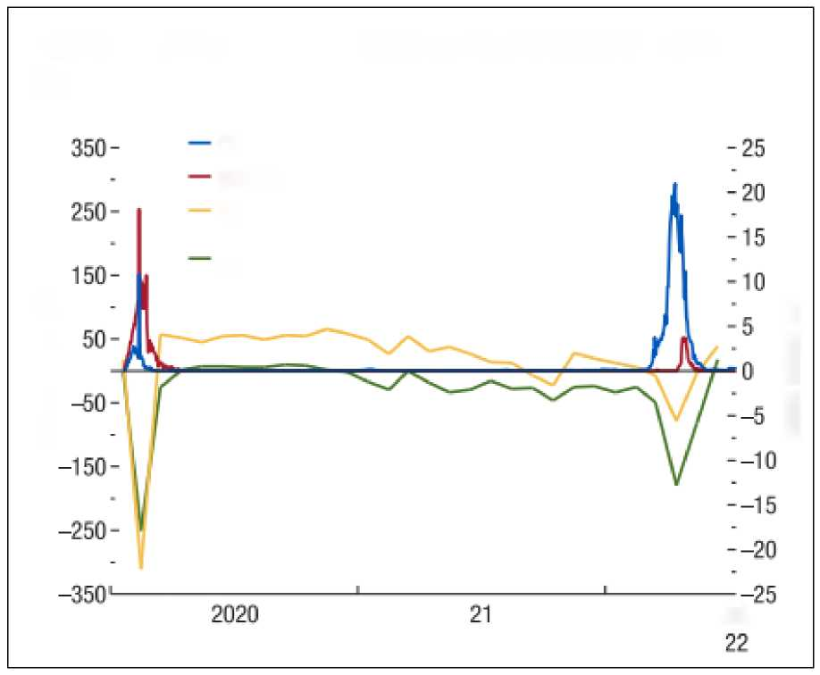
COVID 19 Cases and Manufacturing Activity in China
Figure 3. China: COVID-19 Outbreaks and Supply Chain Disruptions
COVID-19 cases, 100 people
COVID-19 deaths
PMI: Manufacturing output (right scale)
PMI: Manufacturing suppliers' delivery times (right scale)
Number of people
Index minus 50
Jul.
Source: IMF.

Slide 10
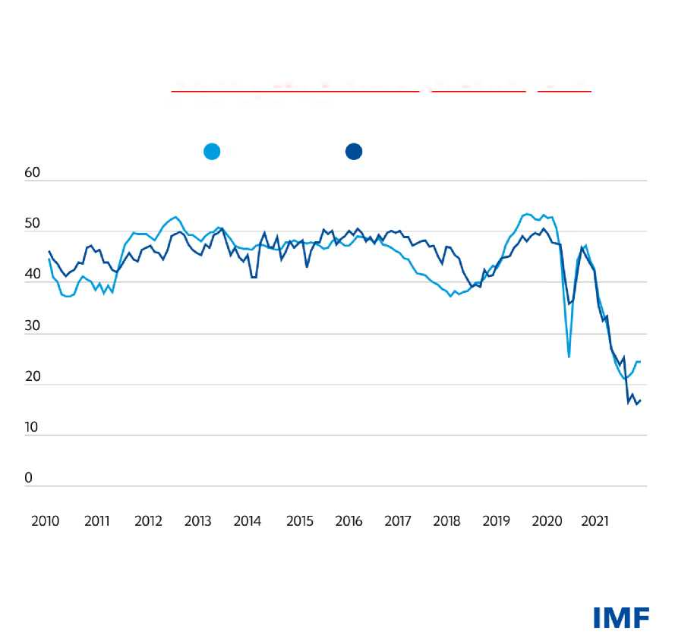
Global Supply Chain Disruptions
Backlogs and bottlenecks: supply chain turmoil
Suppliers' delivery times in the US and EU have slowed considerably — a lower index reflects longer delivery times.
(Manufacturing PMI, suppliers’ delivery times)
European Union
United States
Sources: IHS Markit.
Note: PMI=Purchasing Managers’ Index. Readings above 50 indicate faster delivery times, readings at 50 signal no change, and readings below 50 indicate slower.

Slide 11
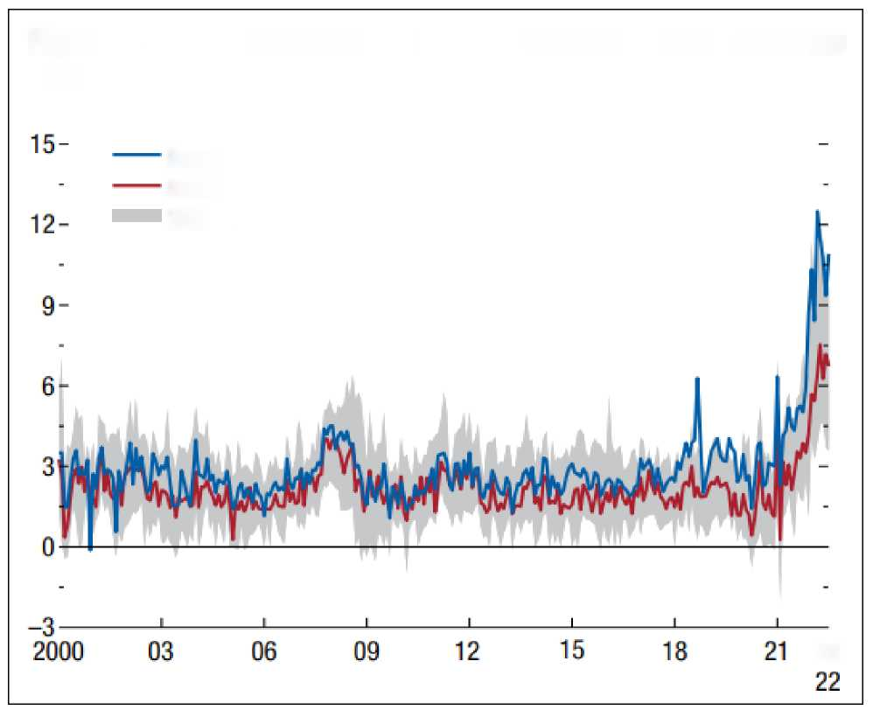
Inflation
Figure 1.6. Core Inflation and Its Distribution across Countries
(Annualized percent)
Mean
Median
25th—75th percentile
Jul.
Source: IMF.

Slide 12
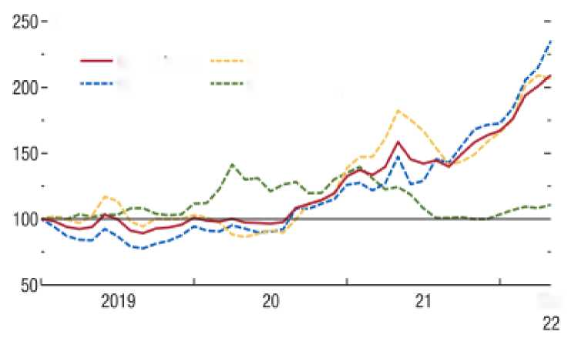
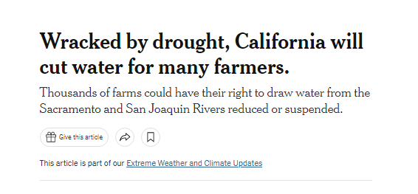

More Inflation
World Food and Energy Prices
1. Cereal Prices
Cereal index
Corn (US)
Wheat (US)
Rice (Thailand)
May
Wracked by drought, California will cut water for many farmers.
Thousands of farms could have their right to draw water from the Sacramento and San Joaquin Rivers reduced or suspended.
Give tbs article
This article is part of our Extreme Weather and Climate Updates

Slide 13
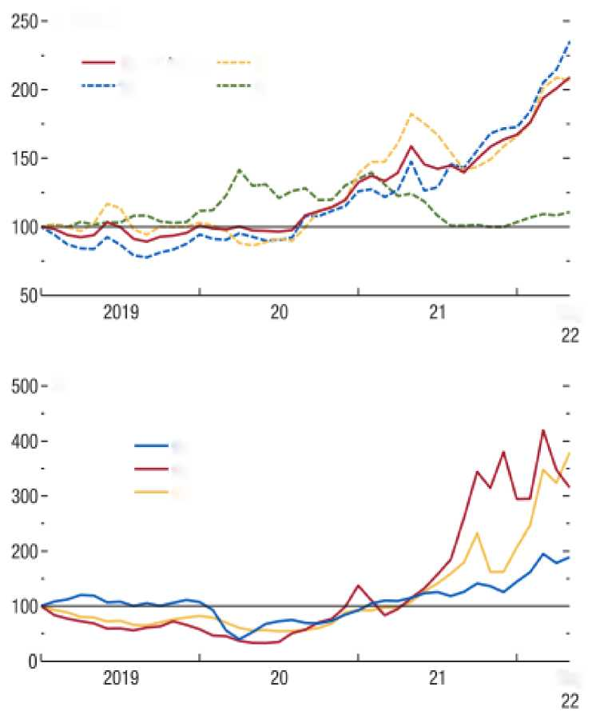
More Inflation
World Food and Energy Prices
1. Cereal Prices
Cereal index
Corn (US)
Wheat (US)
Rice (Thailand)
May
2. Fossil Fuel Prices
Brent crude oil
Natural gas index
Coal index
May

Slide 14
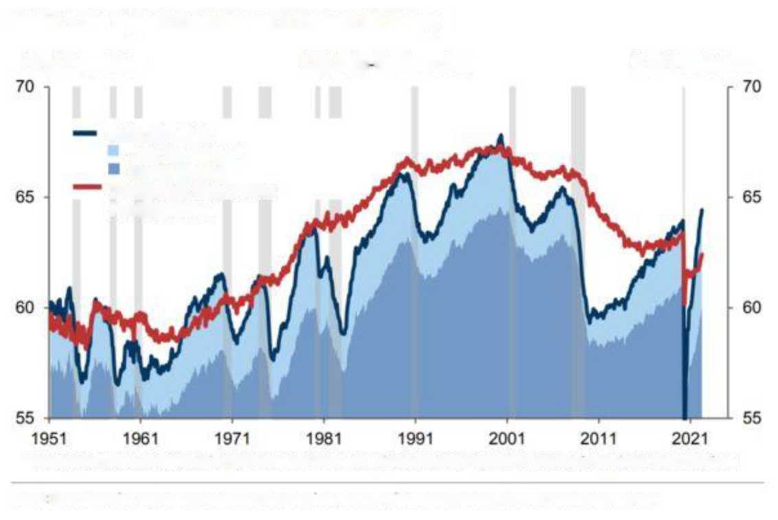
Jobs + Openings > Workers
Exhibit 1: The Tightest Labor Market In Postwar US History
% of Population
US Jobs Workers Gap
% of Population
Jobs of which:
Job Openings*
Employment
Workers (Labor Force Participation)
*Extrapolated before Dec 2000 using the newspaper help-wanted index based on methodology by Regis Barnichon, San Francisco
Source Haver Analytics. Federal Reserve Bank of San Francisco. Data compiled by Goldman Sachs Global Investment Research

Slide 15
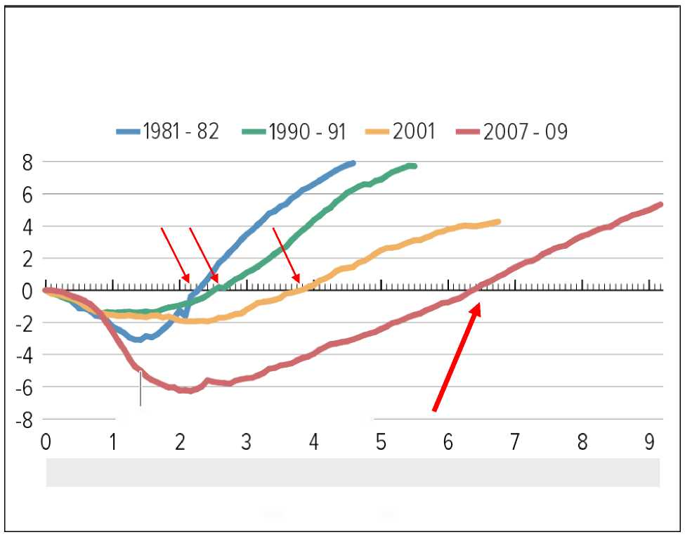
Increasingly “Jobless” US Recoveries
Percent Change in Nonfarm Payroll Employment Since Start of Recession
June 2009: End of Recession
Years from start of recession
Source: CBPP calculations from Bureau of Labor Statistics data.

Slide 16
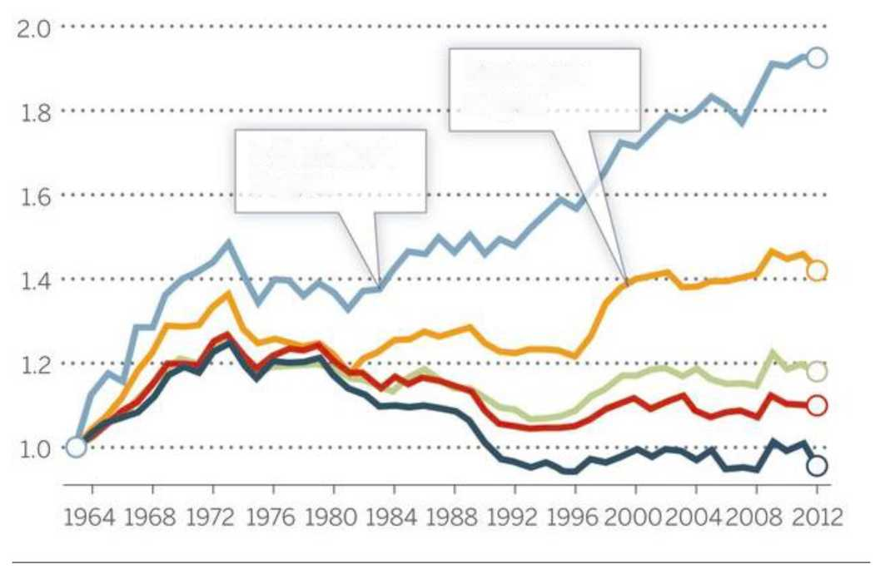
U.S. Income Inequality by Education Autor 2014
Real Weekly Male Earnings Since 1963
Bachelor's degree
> Bachelor's degree

Slide 17
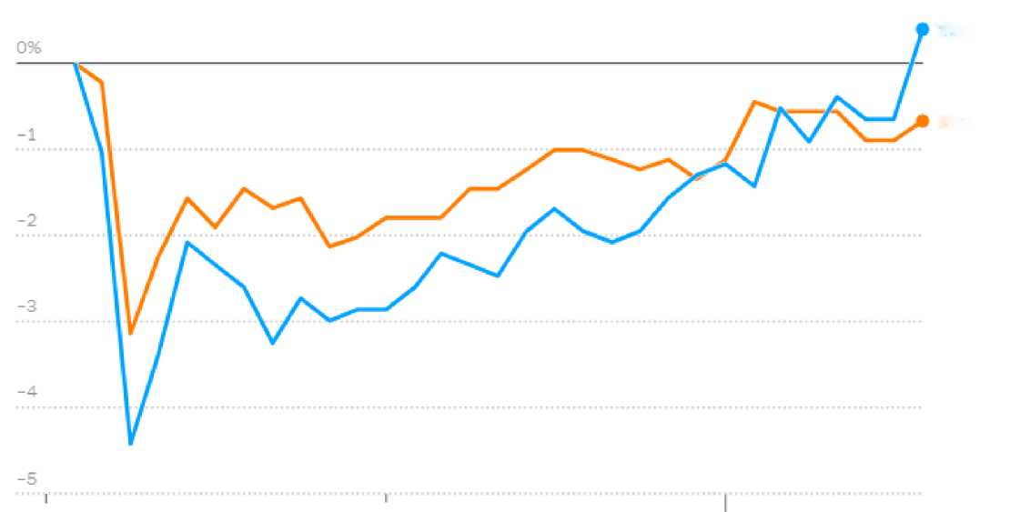
US Labor Shortage
Change in US Labor Force Participation by Gender
Women
Men
2020
2021
2022
Source: New York Times.

Slide 18
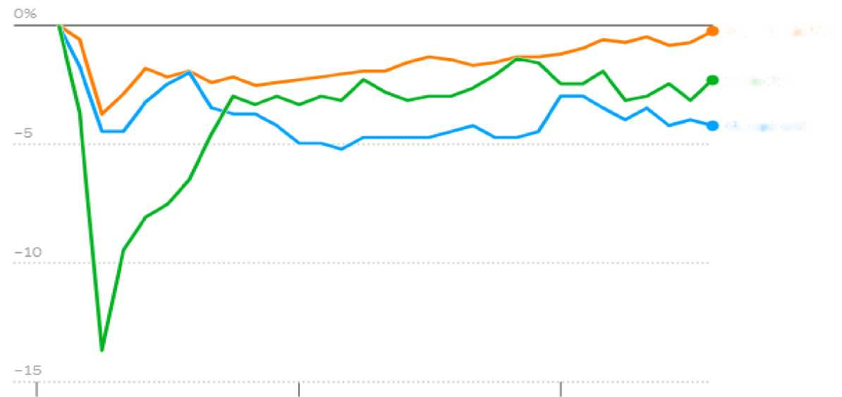
US Labor Shortage
Change in US Labor Force Participation by Age
Ages 25 to 54
16 to 24
55 and older
2020
2021
2022
Source: New York Times.

Slide 19
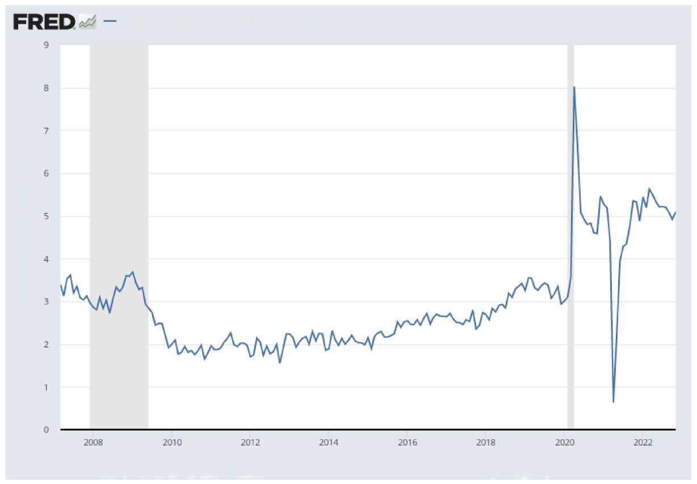
US Wage Growth
Average Hourly Earnings of All Employees, Total Private
Percent Change from Year Ago
Source: U.S. Bureau of Labor Statistics
myf.red/g/XiVB

Slide 20
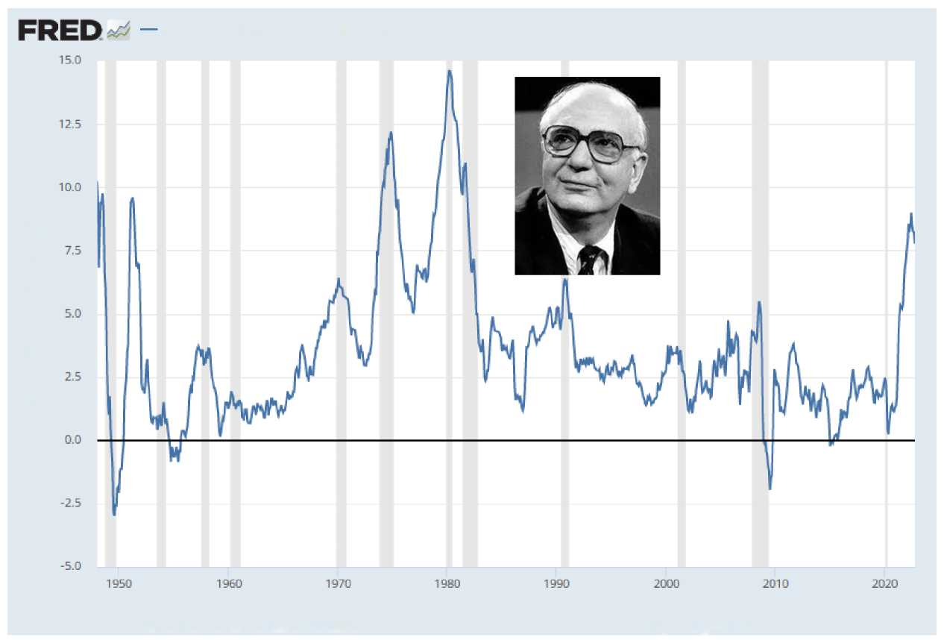
1980s vs Now
Consumer Price Index for All Urban Consumers: All kems in U.S. City Average
Percent Change from Year Ago
Source: U.S. Bureau of Labor Statistics
myf.red/g/WhH1

Slide 21
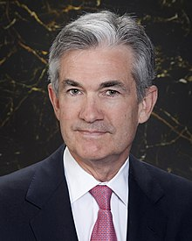


Jerome Powell
Christine Lagarde
Matin Bailey

Slide 22
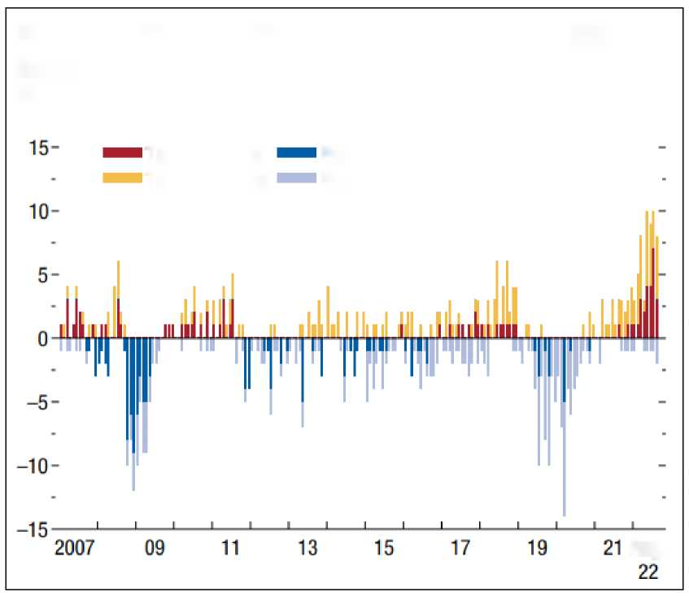
Monetary Policy
Figure 1.2. Change in Monetary Policy Cycle among G20 Economies
(Number of increases and cuts in policy rates)
Tightening AEs
Easing AEs
Tightening EMs
Easing EMs
Aug.
Source: IMF.

Slide 23
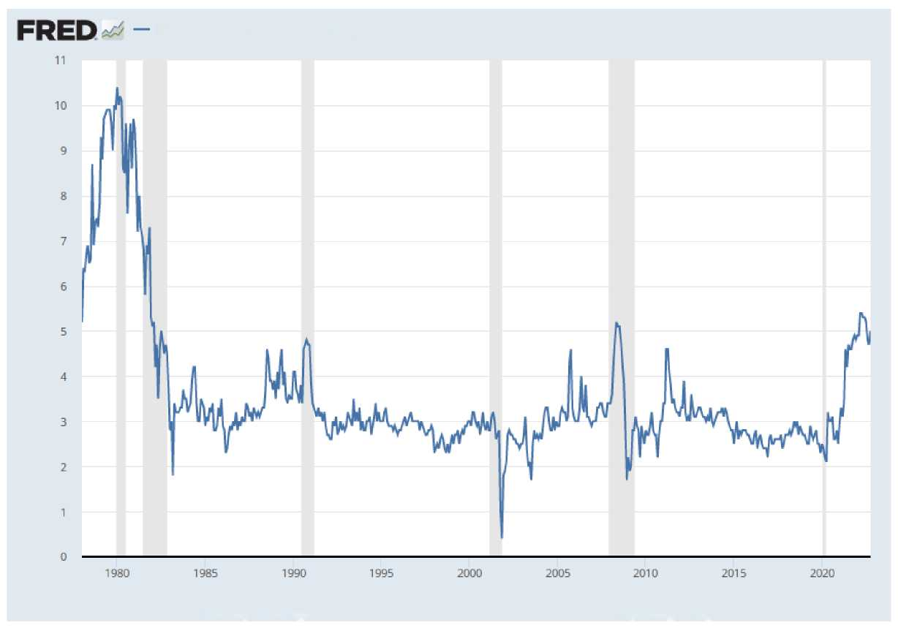
US Inflation Expectations?
University of Michigan: Inflation Expectation
Percent
Source: University of Michigan
myf.red/g/WYOg

Slide 24
Do you think a US recession is coming?

Slide 25
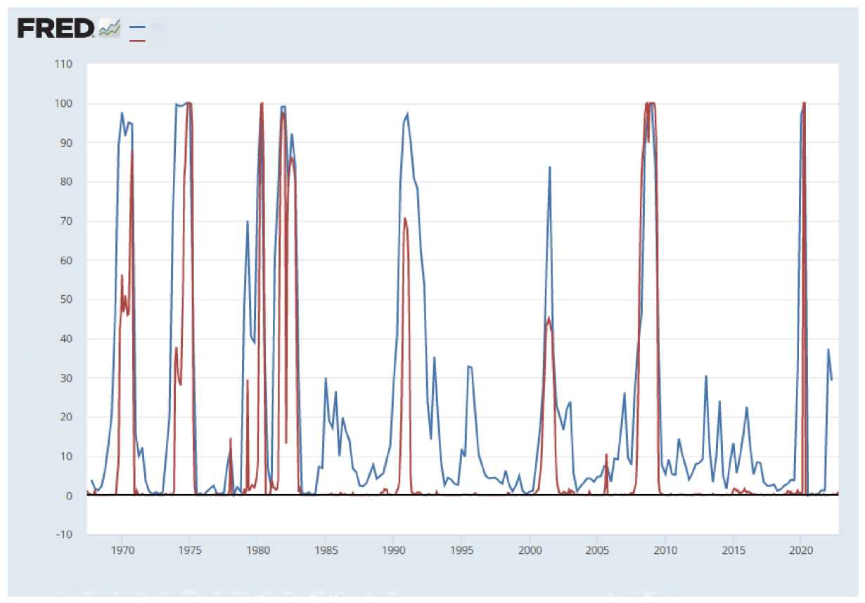
Recession Probability?
GDP-Based Recession Indicator Index
Smoothed U.S. Recession Probabilities
Percentage Points , Percent
Sources: Chauvet, Marcelle; Hamilton, James; Piger, Jeremy Max
myf.red/g/XiWw

Slide 26
Appendix: Long Run Growth

Slide 27
GDP = Productivity * Capital^{0.7} * Labor^{0.3}

Slide 28
What to Expect from Now to 2075?
Slower growth around the world, lead by weaker population growth
Continued convergence of emerging markets to developed country income, lead by Asia
Less inequality across countries, but more inequality within countries

Slide 29
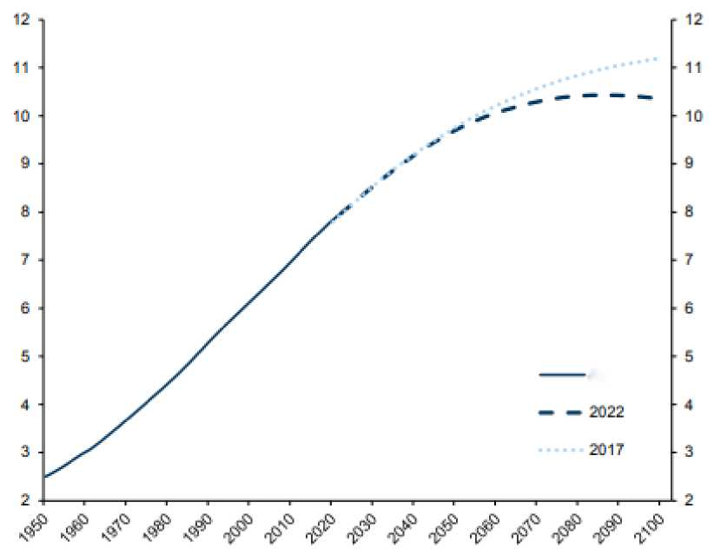
UN Population Projection
Billion
Actual

Slide 30
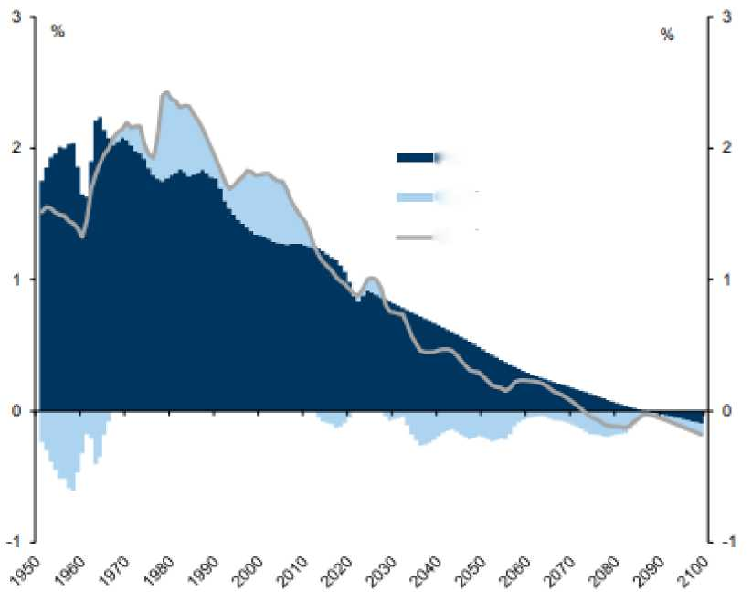
UN Population Projection
Percent
Growth
Population growth
Working age ratio
Working age population growth

Slide 31
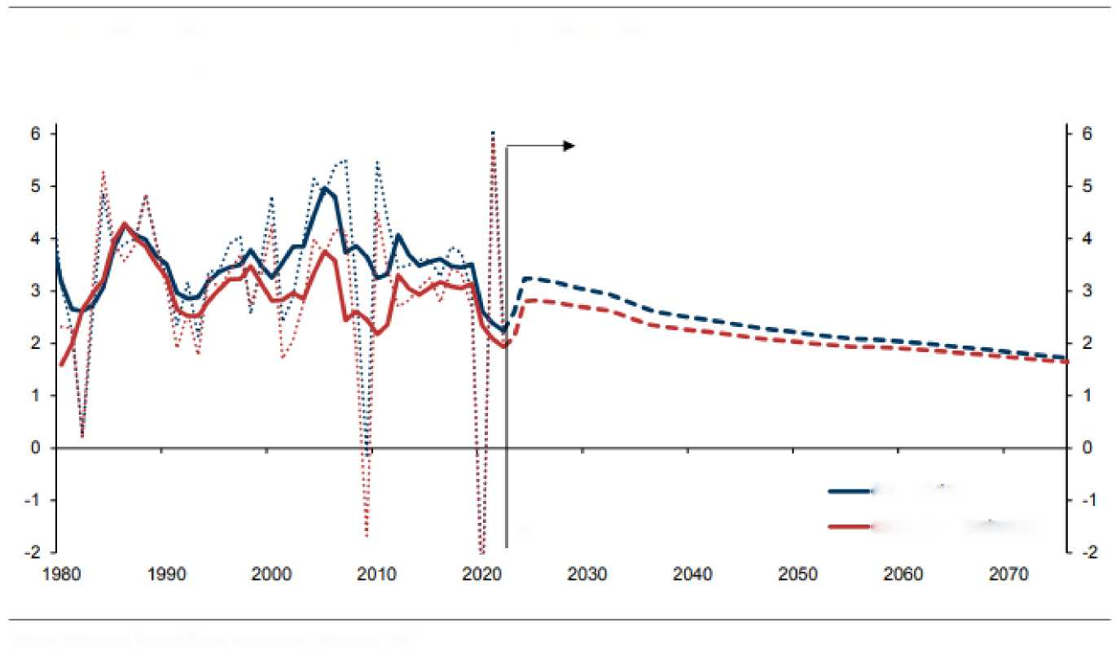
Growth Projections
Exhibit 1: Global Potential Growth on a Gradually Declining Path
Global GDP growth; solid line - 5Y centred average; dotted line - annual growth
Global GDP Growth (%)
PPP Weighted
Forecast
Market FX Weighted
Source: Goldman Sachs Global Investment Research. IMF

Slide 32
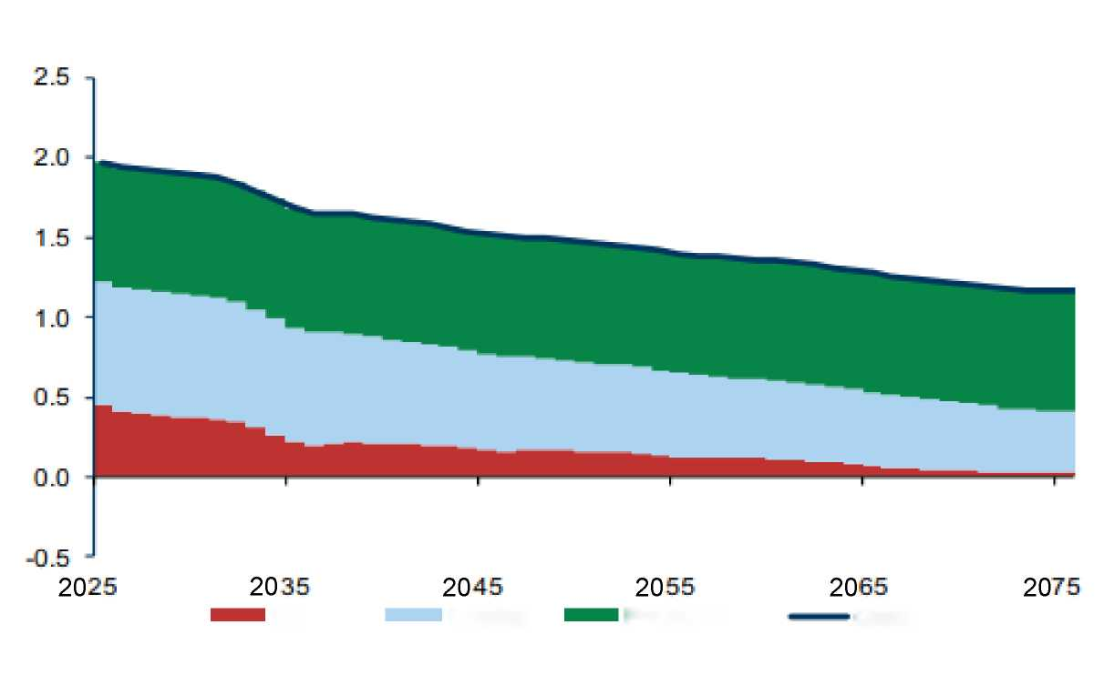
USA
GDP Growth Decomposition
Labour
Capital
Productivity
Growth
Source: Goldman Sachs Global Investment Research

Slide 33
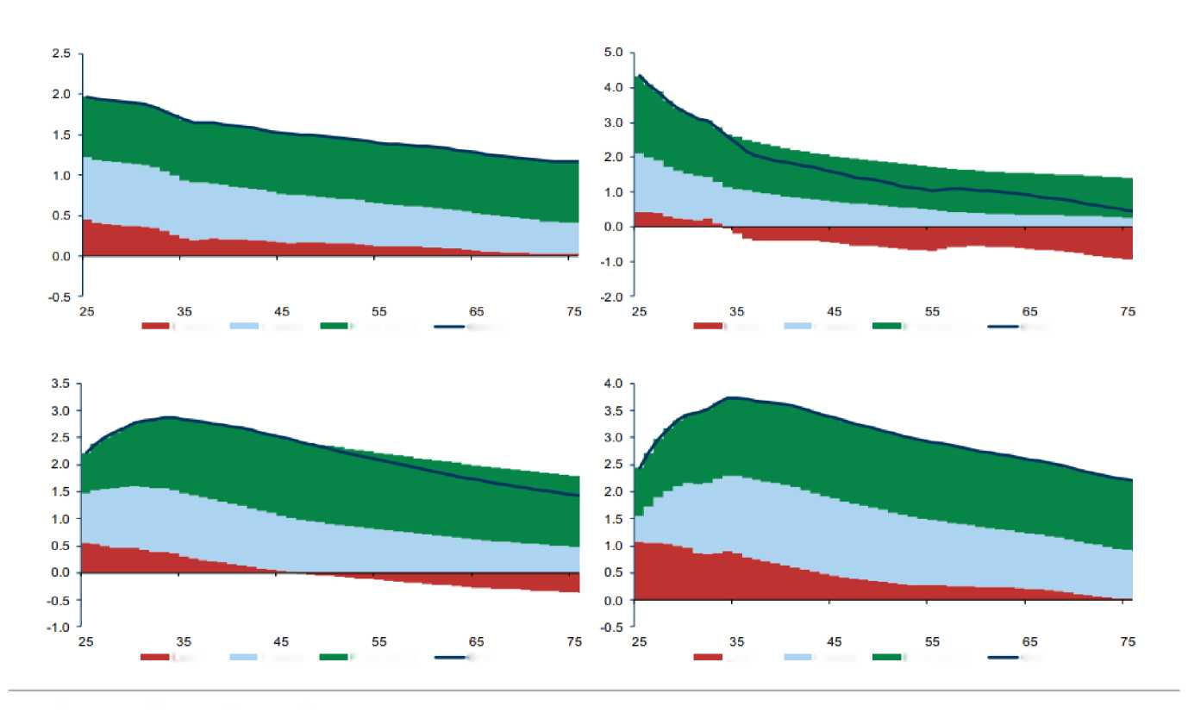
Growth Projections
USA
CHN
GDP Growth Decomposition
GDP Growth Decomposition
Labour
Capital
Productivity
Growth
Labour
Capital
Productivity
Growth
BRA
GDP Growth Decomposition
ZAF
GDP Growth Decomposition
Labour
Capital
Productivity
Growth
Labour
Capital
Productivity
Growth
Source: Goldman Sachs Global Investment Research

Slide 34
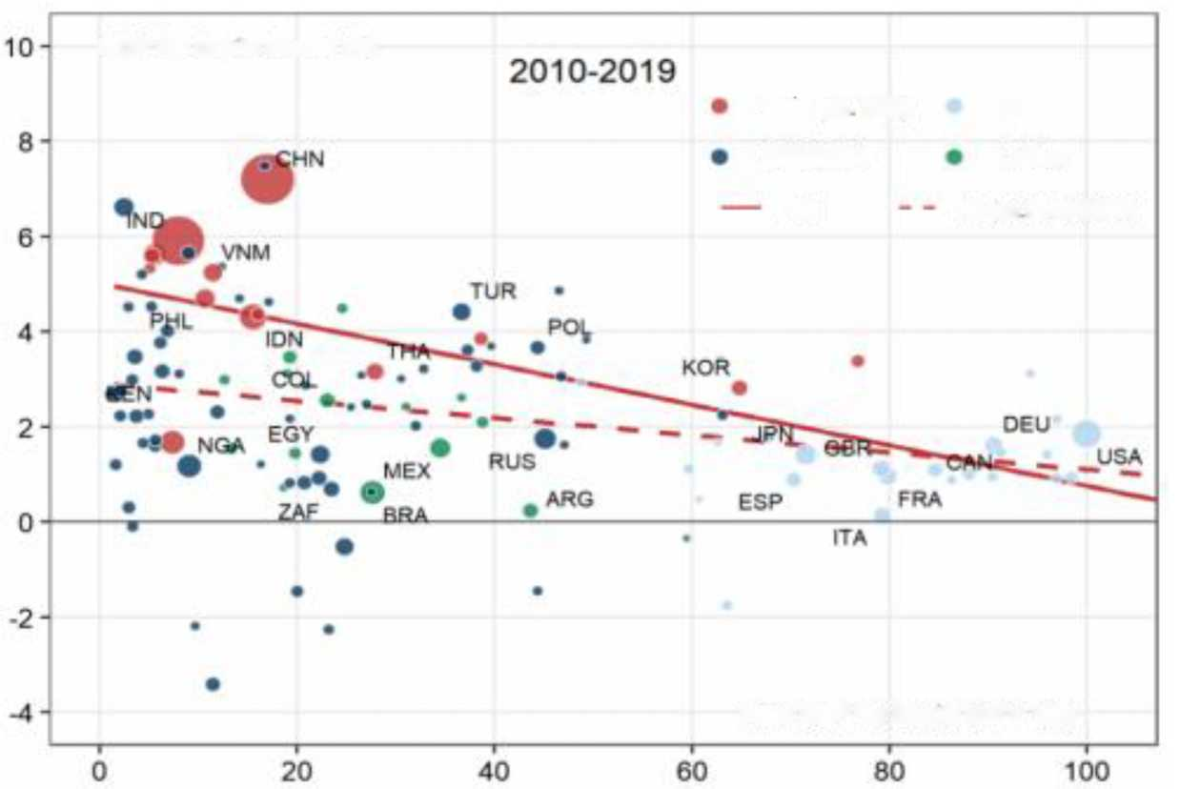
Convergence
GDP Per Capita Growth (%)
Asia (ex. DM)
DM
CEEMEA
LatAm
All
All (ex. CHN&IND)
Initial GDP Per Capita (US =100)
Source: Goldman Sachs Global Investment Research

Slide 35
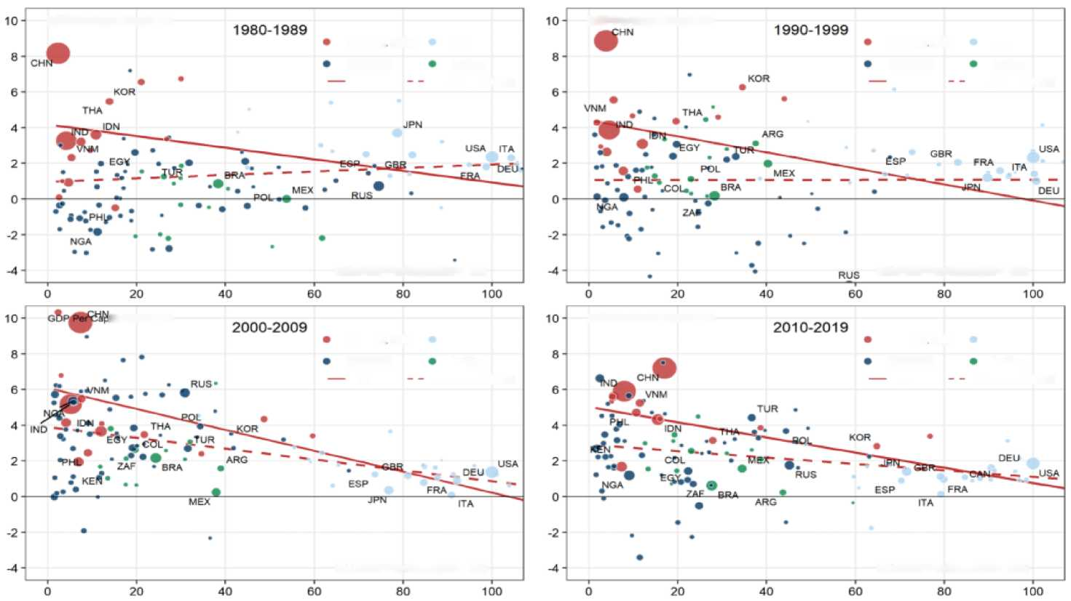
Convergence
GDP Per Capita Growth (%)
GDP Per Capita Growth (%)
Asia (ex. DM)
DM
Asia (ex. DM)
DM
CEEMEA
LatAm
CEEMEA
LatAm
All
All (ex. CHN&IND)
All
All (ex. CHN&IND)
Initial GDP Per Capita (US = 100)
Initial GDP Per Capita (US = 100)
GDP Per Capita Growth (%)
GDP Per Capita Growth (%)
Asia (ex. DM)
DM
Asia (ex. DM)
DM
CEEMEA
LatAm
CEEMEA
LatAm
All
All (ex. CHN&IND)
All
All (ex. CHN&IND)
Initial GDP Per Capita (US = 100)
Initial GDP Per Capita (US = 100)
Source: Goldman Sachs Global Investment Research

Slide 36
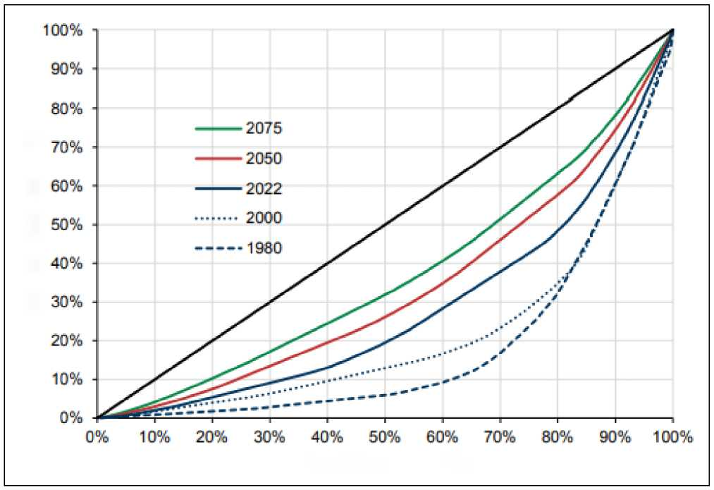
Across-Country Inequality
Share in Global GDP (%)
Population Share (%)
Source: Goldman Sachs Global Investment Research

Slide 37
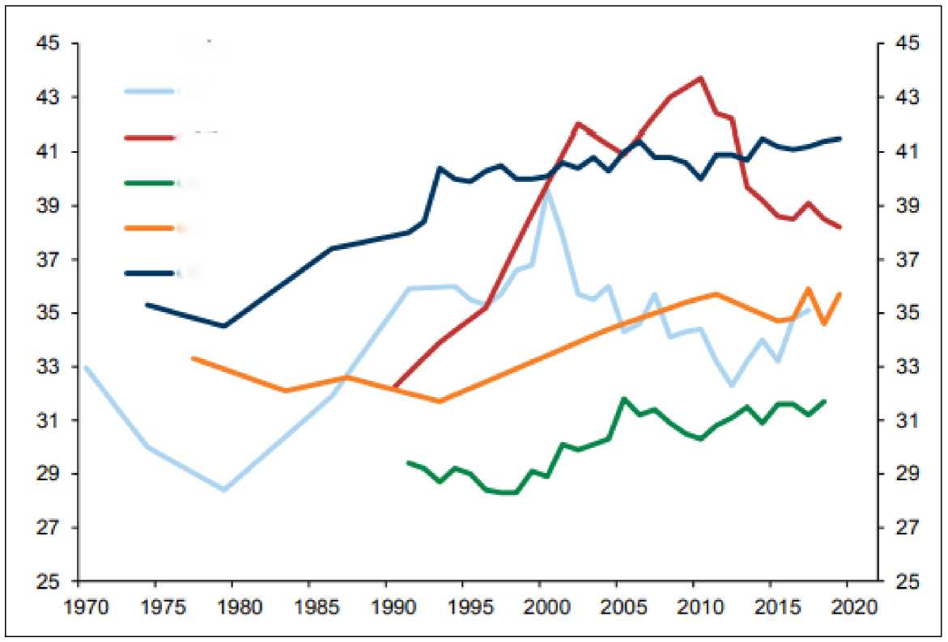
Within-Country Inequality
GINI coefficient
UK
China
Germany
India
US
Source: Goldman Sachs Global Investment Research

Slide 38
Thanks!

Slide 39
Appendix: The Lingering Impact of the Great Recession

Slide 40
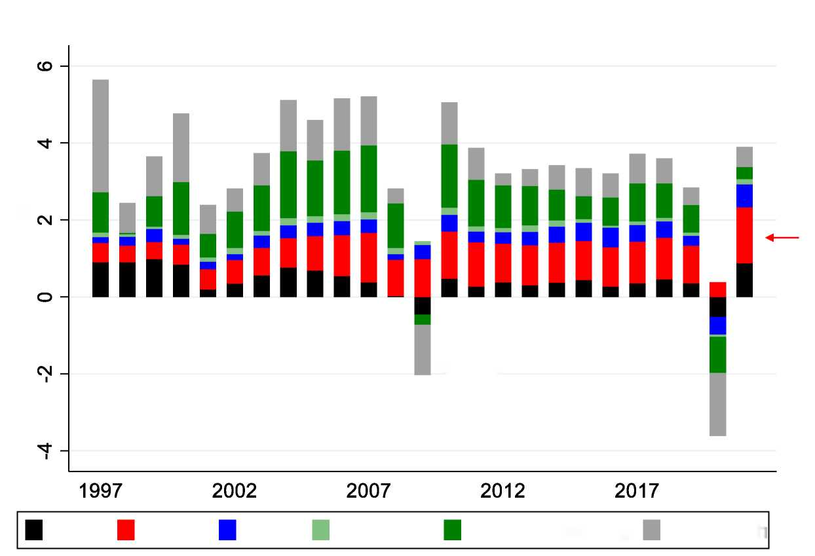
World GDP Growth 1997-2021
Contribution to World GDP Growth
Percent Growth
Great Recession
USA
China
India
SS Africa
Other Developing
Other Rich
Notes:
.do file in /executive/global_growth

Slide 41
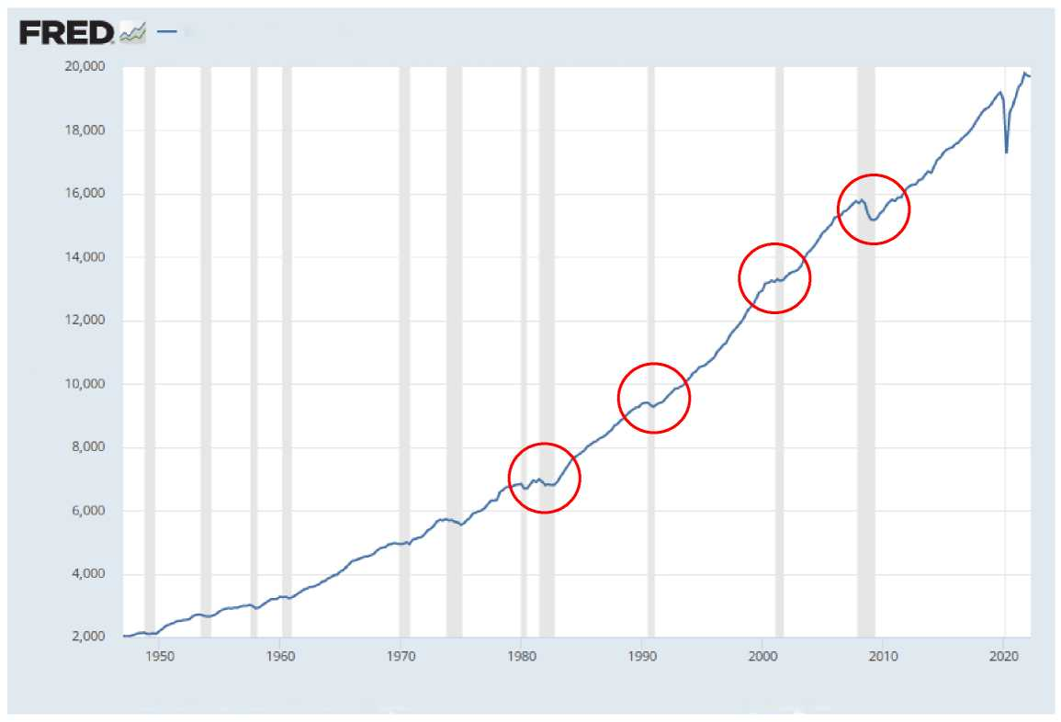
US GDP
Real Gross Domestic Product
Billions of Chained 2012 Dollars
Source: U.S. Bureau of Economic Analysis
myf.red/g/T6zv

Slide 42
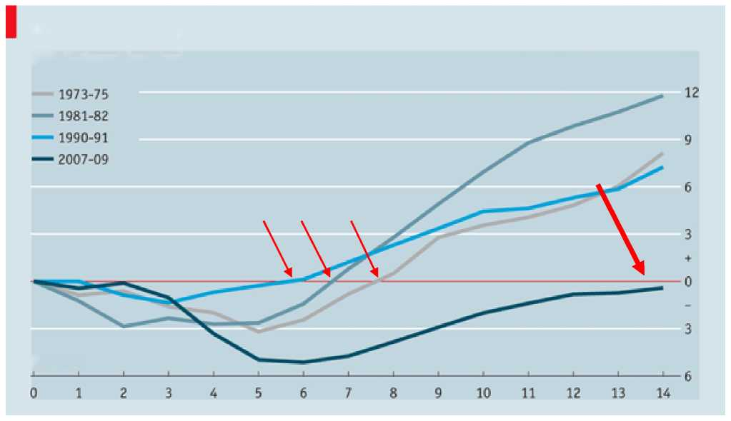
The Great Recession Was Extreme!
US recessions and recoveries
GDP, % change from peak
Quarters

Slide 43
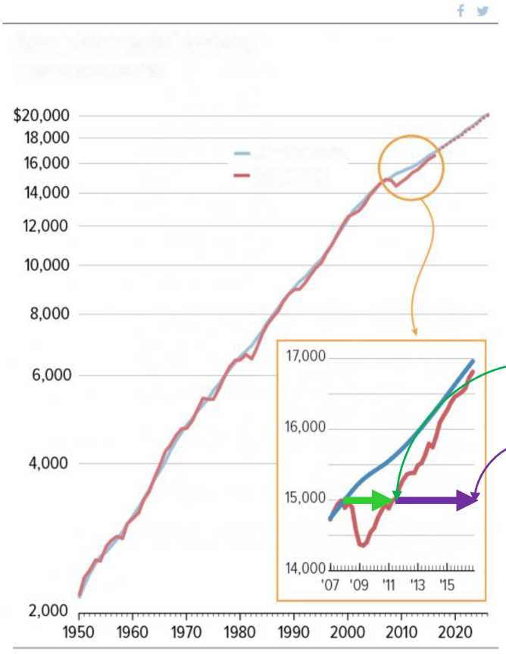
The US Output Gap
An “output gap” is the difference between actual and potential GDP
It measures the severity of a recession
Gross Domestic Product, United States
Billions of 2009 dollars
Potential GDP
Actual GDP
Time it took GDP to get back to old level
Time it took GDP to get back to potential GDP
Source: BEA. Note the log scale: Constant slope means constant growth rate.

Slide 44
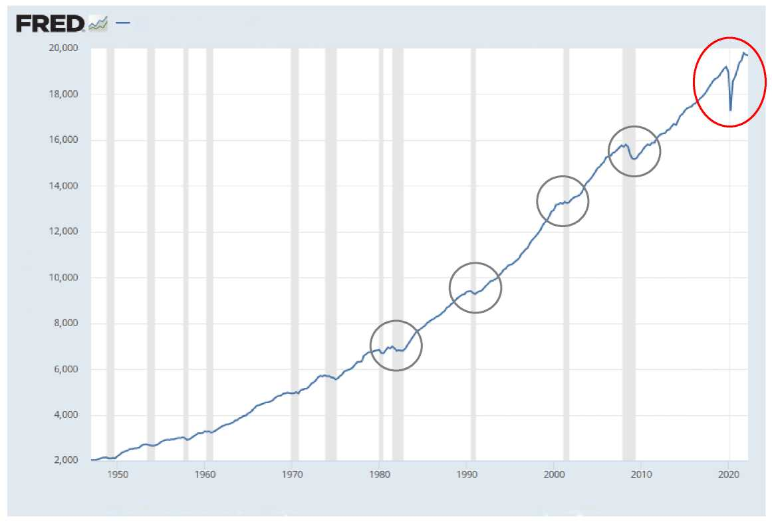
US GDP
Real Gross Domestic Product
Billions of Chained 2012 Dollars
Source: U.S. Bureau of Economic Analysis
myf.red/g/T6zv

Slide 45
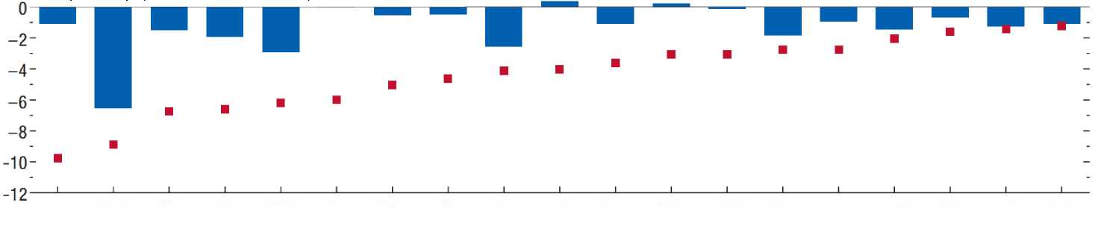
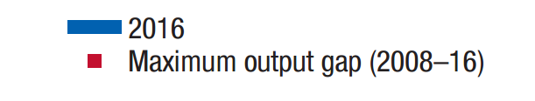
Output Gaps 10 Years Later Source: IMF
Output Gap (% of Potential GDP)
BAL
GRC
JPN
ESP
PRT
IRL
TWN
USA
ITA
DEU
CAN
SCN
GBR
FRA
NLD
KOR
BEL
AUS
CHE
2016 Output Gap
Maximum Output Gap 2008-16

Slide 46
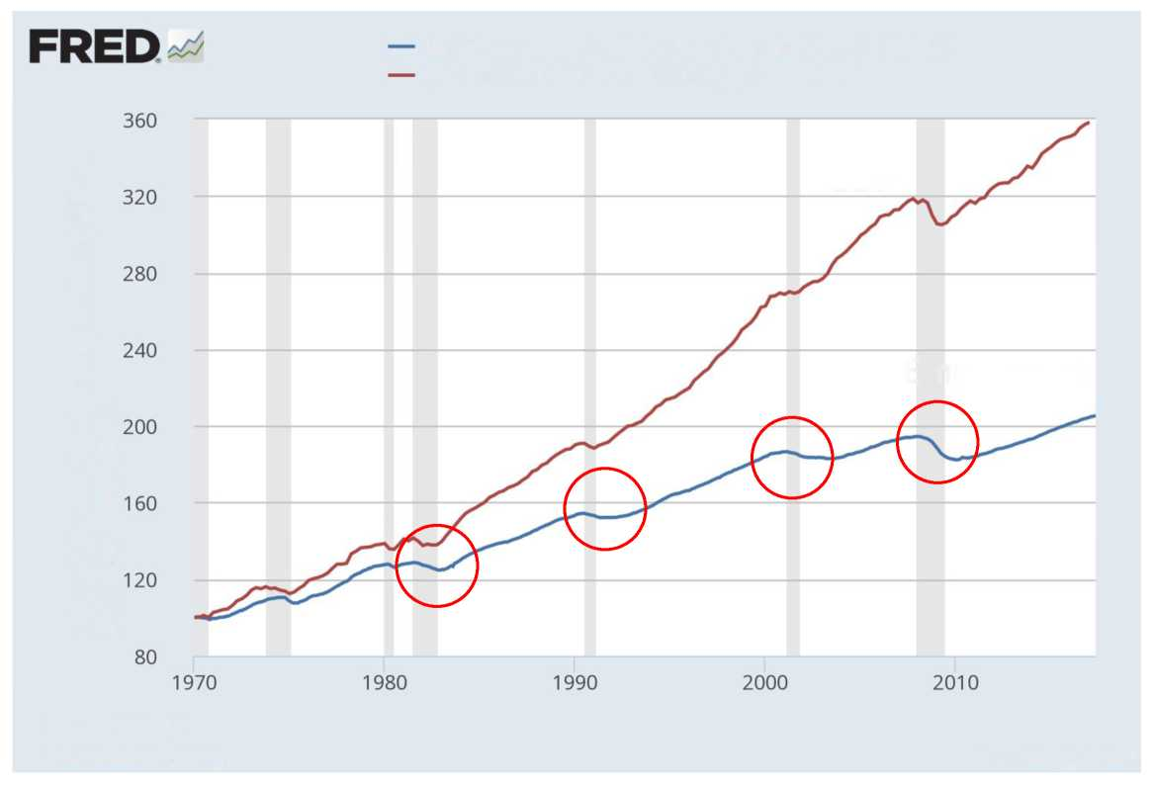
US Employment
(All Employees: Total Nonfarm Payrolls), Jan 1970=100
(Real Gross Domestic Product), Q1 1970=100
Index of (Thousands of Persons), Index of (Billions of Chained 2009 Dollars)
GDP
Employment
Sources: BEA, BLS
fred.stlouisfed.org
myf.red/g/ehaM
Notes:
(129733-138463)/138463

Slide 47

Increasingly “Jobless” US Recoveries
Percent Change in Nonfarm Payroll Employment Since Start of Recession
June 2009: End of Recession
Years from start of recession
Source: CBPP calculations from Bureau of Labor Statistics data.

Slide 48
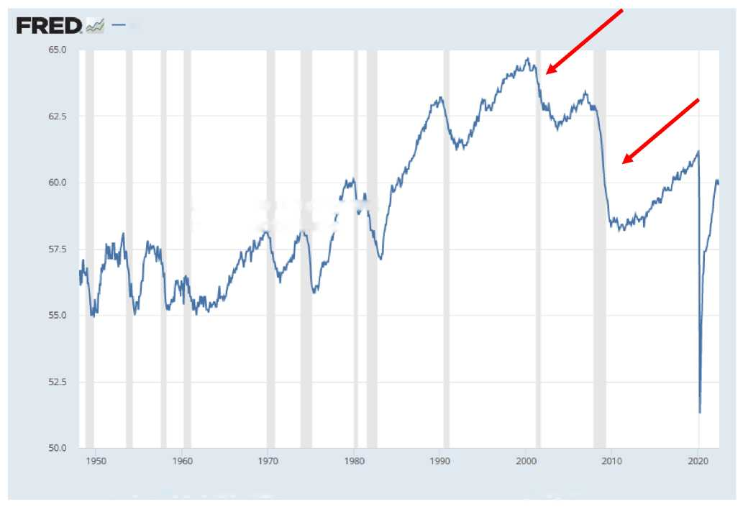
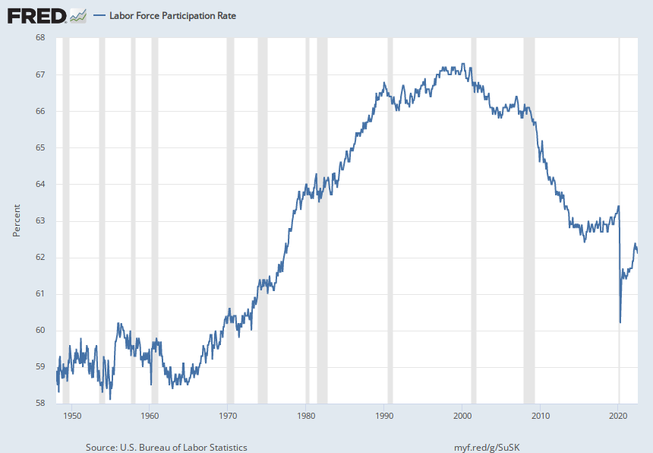
Severe Drop in US Labor Force Participation
Employment-Population Ratio
US Civilian Employment to Population Ratio
Percent
Source: U.S. Bureau of Labor Statistics
myf.red/g/SIHR

Slide 49
U.S. Manufacturing Employment
U.S. Manufacturing Employment
NBER Recessions Shaded
What happened in 2001?
Employment (million)
Source: Pierce and Schott (2012)

Slide 50
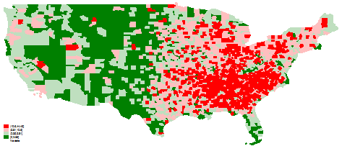
Exposure to Imports from China
0-25th
26th-50th
51th-75th
76th-100th

Slide 51
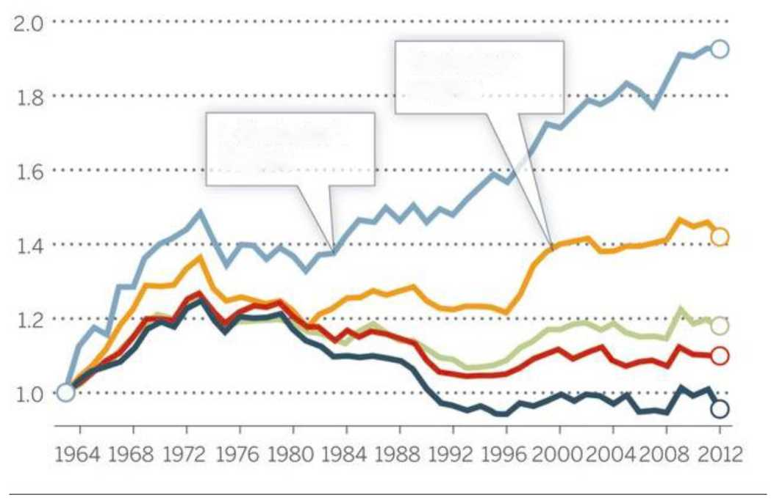
U.S. Income Inequality by Education Autor 2014
Real Weekly Male Earnings Since 1963
Bachelor's degree
> Bachelor's degree

Slide 52
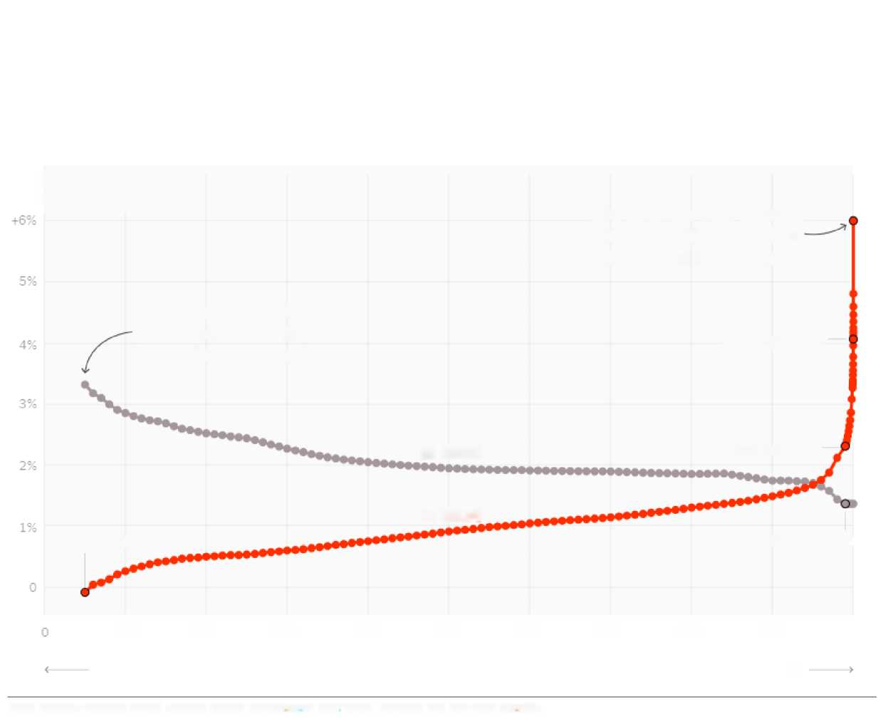
Our Broken Economy, in One Simple Chart
By DAVID LEONHARDT
AUG. 7, 2017
INCOME GROWTH
Over previous 34 years
But now, the very affluent (the 99.999th percentile) see the largest income growth.
The poor and middle class used to see the largest income growth.
99.99th percentile
In 1980
99th percentile
In 2014
5th percentile
99th percentile
10th
20th
30th
40th
50th
60th
70th
80 th
90th
100th
Lower Income
INCOME PERCENTILE
Higher Income
Note: inflation-adjusted annual average growth using income afte^{r} taxes, transfers and non-cash benefits.

Slide 53
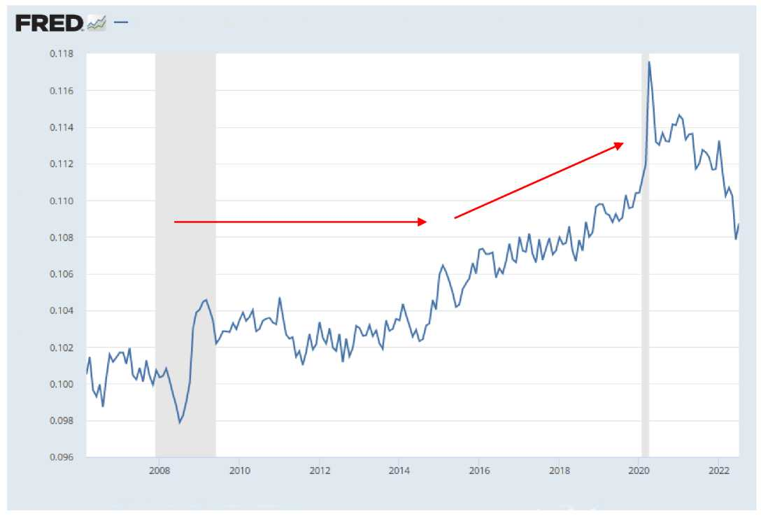
US Wage Growth Since the Great Recession
Average Hourly Earnings of All Employees, Total Private/Consumer Price Index for All Urban Consumers: All Items In U.S. City Average
$ per Hour/lndex 1982-1984=100
?
Source: U.S. Bureau of Labor Statistics
myf.red/g/Thgu

Slide 54
Appendix: The rise of uncertainty

Slide 55
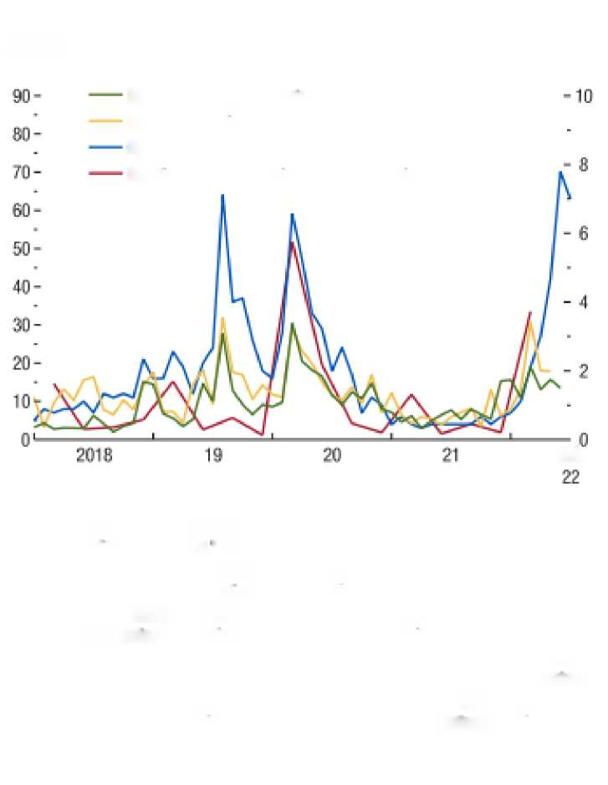
Uncertainty!
Figure 5. Rising Uncertainties and Risks
(Index; ratio on right scale)
Monetary policy uncertainty
National security policy uncertainty
Recession fear
Relative risk of recession in G7 economies (right scale)
Jul.
Sources; Scott R. Baker, Nicholas Bloom, and Steven J. Davis, "Measuring Economic Policy Uncertainty," Quarterly Journal of Economics, 2016,131 (4): 1593-636; John C. Bluedom, Jörg Decressin, and Marco E. Terrones, "Do Asset Price Craps Foreshadow Recessions?" International Journal of Forecasting, 2016, 32 (2); 518-526; Google Trends; and IMF staff calculations.
Note: Monetary policy uncertainty Is rescaled by 1/10 and is based on Baker, Bloom, and Davis (2016); national security policy uncertainty is rescaled by 1/10; recession fear is based on the volume of Google searches for the word "recession" worldwide with numbers representing search interest relative to the highest point since 2008; relative probability of recession in G7 economies Indicates ratio of current probability to normal-times probability of a new recession and is based on Bluedom, Decressin, and Terrones (2016), G7 = Group of Sevan,

Slide 56
Other Risks

Slide 57

Energy/Europe
Figure 6. Declining Flow of Russian Pipeline Gas to the EU
(Million cubic meters per day)
Baltics
Turk Stream
Belarus
Ukraine
Nord Stream 1
Total
Jan.
Mar.
May
Jul.
Sep.
Nov.
Jan.
Mar.
May
Jul.
Sources: European Network of Transmission System Operators for Gas; Gas Transmission System Operator of Ukraine; and IMF staff calculations.
Note: Latest data available are tor July 12,2022. Recent data are provisional. EU = European Union.

Slide 58

Emerging Market Debt
Figure 7. Emerging Market Debt: Rising Vulnerabilities
(Percent, three-week average)
Share of EMBIG issuers with yields above 10 percent
Share of EMBIG issuers with spreads above 1,000 bps
Jul.
Sources: Bloomberg Finance L.P.; J.P. Morgan Emerging Market Bond Index; and IMF staff calculations.
Note: bps = basis points; EMBIG = Emerging Market Bond Index Global.

Slide 59

Longer Run: Demographics!
1. Population Growth¹ (Percent)
"Old" AEs
"New"AEs
EMs excluding China
China
LIDCs
"Old" AEs
"New"AEs
EMs excluding China
China
LIDCs
3. Share of Workers Aged 55-64 in Advanced Economies²
4. Share of Workers Aged 55-64 in Emerging Market Economies³
(Percent)
(Percent)
Median
Interquartile range
Median
Interquartile range

Slide 60
Longer Run: Demographics!
2. Working - Age Population Growth¹ (Percent)
"Old" AEs
"New" AEs
EMs excluding China
China
LIDCs

Slide 61
What do you think??

Slide 62
Appendix

Slide 63

U.S. Wages versus Productivity Wikipedia
Cumulative Change (%)
Productivity
Real Median Family Income
Source Analysis of Current Population Survey Annual Social and Economic Supplement Historical Income Tables (Table F-5) and Bureau of Labor Statistics, Productivity-Major Sector Productivity and Costs Database (2012)

Slide 64

Wages Have Diverged from Productivity
Different recessions
United States
Britain
Output per hour
Output per hour
Median real wages
Median real wages
Unemployment rate, %
Unemployment rate, %
Sources: ONS; OECD; BLS; Federal Reserve; Insee
Economist.com

Slide 65

Falling US Labor Share of GDP
4. Labor Share (Percent)

Slide 66

Rising Firm Market Power
1. Markups
(Index, 2000 = 1)

Slide 67

Rising Firm Market Power….Especially Among Largest
1. Evolution of Markups, by Firm Groups (Index, 2000 = 1)
Top decile firms
Rest of firms

Slide 68

U.S. Income Inequality by Education Autor 2014
Real Weekly Male Earnings Since 1963
Bachelor's degree
> Bachelor's degree

Slide 69

Our Broken Economy, in One Simple Chart
By DAVID LEONHARDT
AUG.7,2017
INCOME GROWTH
Over previous 34 years
But now, the very affluent (the 99.999th percentile) see the largest income growth.
The poor and middle class used to see the largest income growth.
99.99th percentile
In 1980
99th percentile
In 2014
5th percentile
99th percentile
10th
20th
30th
40th
50th
60th
70th
80th
90th
100th
Lower Income
INCOME PERCENTILE
Higher Income
Note: inflation-adjusted annual average growth using income afte^{r} taxes, transfers and non-cash benefits.

Slide 70
Risks
Policy uncertainty:
Trade
Monetary Policy
Geopolitical uncertainty
Income Inequality
Long-run risks
Demographics

Slide 71
Demographics IMF 2018
1. Population Growth¹ (Percent)
"Old" AEs
"New"AEs
EMs excluding China
China
LIDCs
"Old" AEs
"New"AEs
EMs excluding China
China
LIDCs
3. Share of Workers Aged 55-64 in Advanced Economies²
4. Share of Workers Aged 55-64 in Emerging Market Economies³
(Percent)
(Percent)
Median
Interquartile range
Median
Interquartile range

Slide 72
Demographics IMF 2018
2. Working-Age Population Growth¹ (Percent)
"Old" AEs
"New" AEs
EMs excluding China
China
LIDCs

Slide 73
Demographics IMF 2018
similar pattern has formed in emerging market and developing economies in the past 10 years, although the share of older workers remains below that in advanced economies.
1. Population Growth¹ (Percent)
3. Share of Workers Aged 55-64 in Advanced Economies²
4. Share of Workers Aged 55-64 in Emerging Market Economies³
(Percent)
(Percent)
Median
Interquartile range
Median
Interquartile range

